Slide 1



WEP2021-VC2-G4 | Mock Up

Slide 2
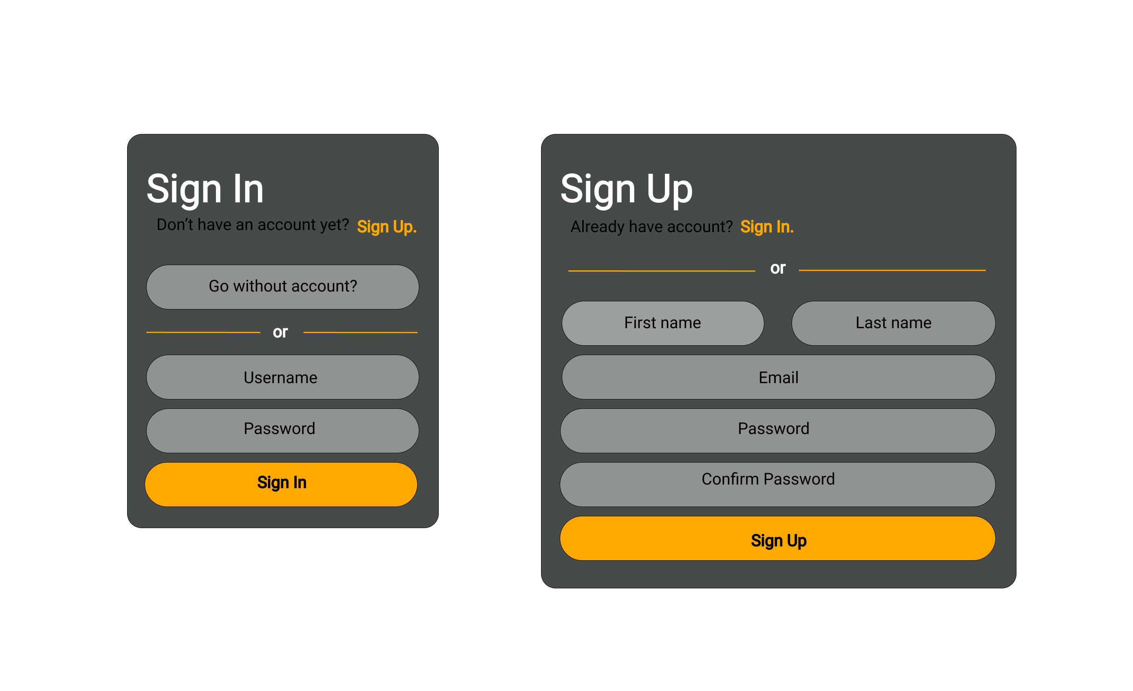
Sign In | Sign Up Mock Up

Slide 3
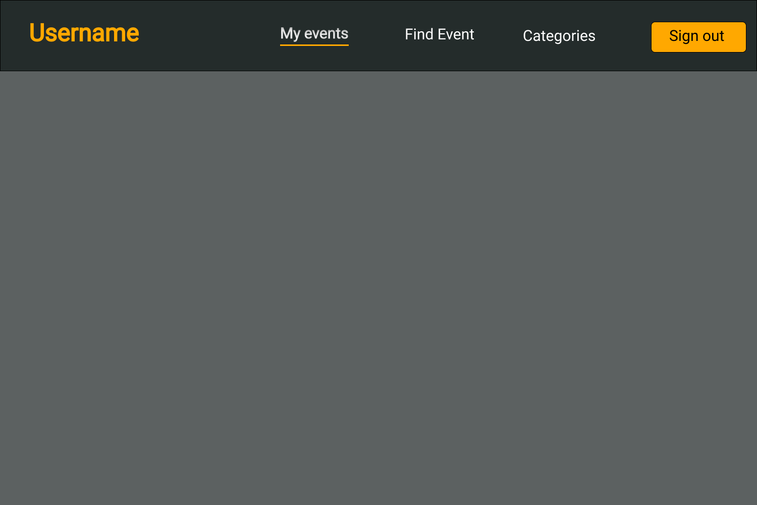
Menu Mock Up

Slide 4
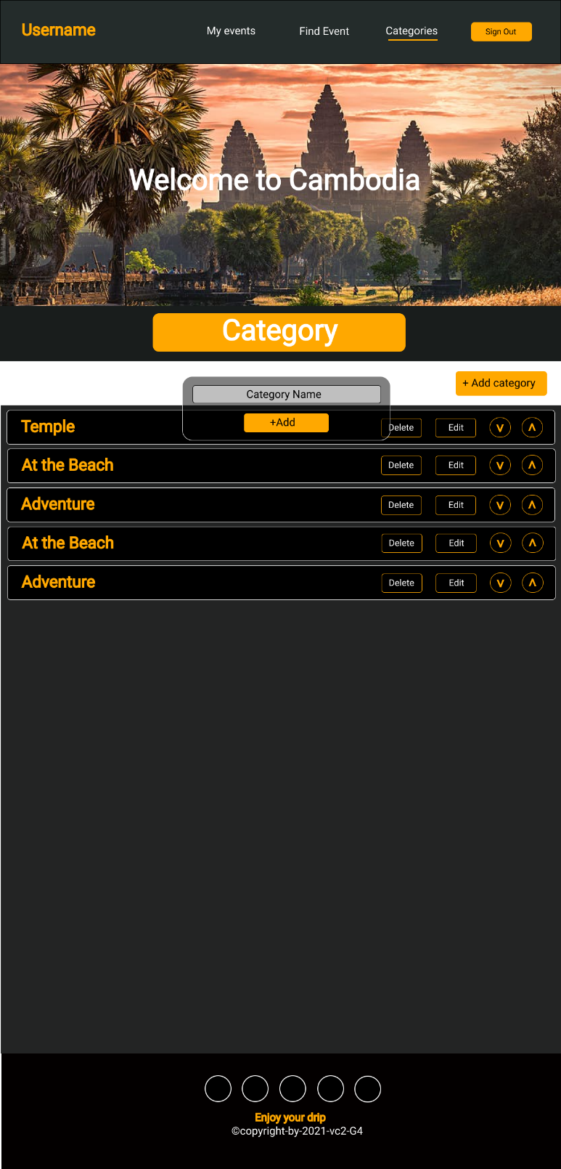
Category Mock Up

Slide 5
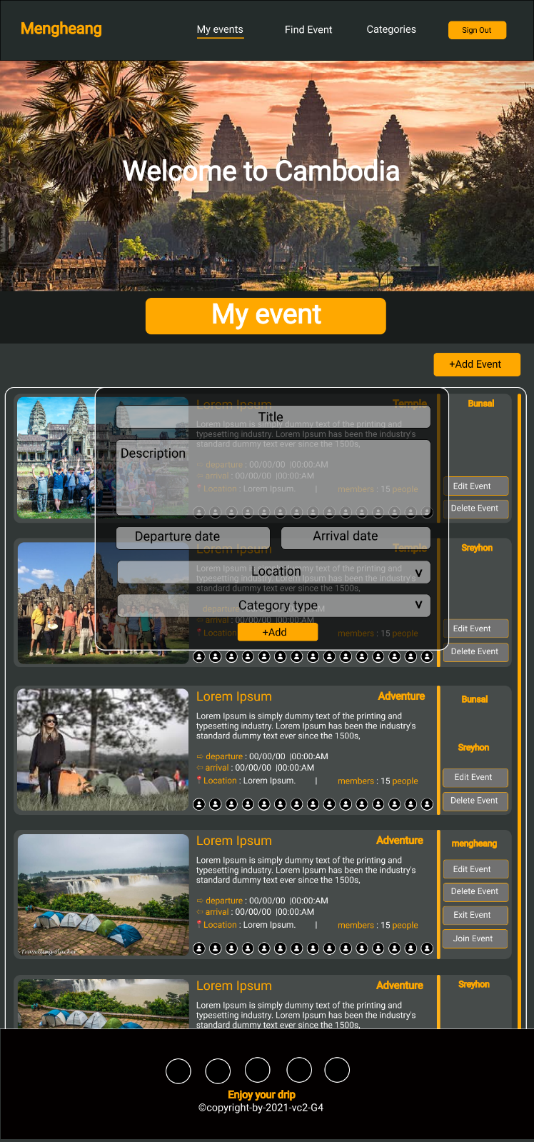
My Event Mock Up

Slide 6
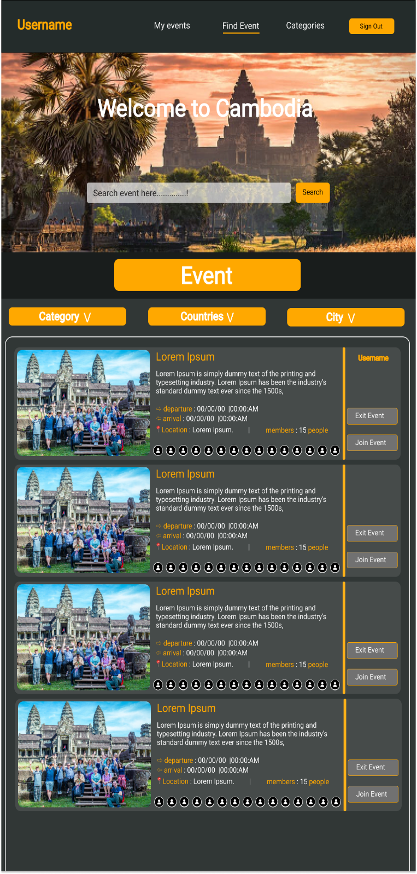
Find Event Mock Up

